Slide 1
What Does Research Tell Us About Poverty?
A Special Education Perspective
Jennifer Webb
Neslihan Unluol Unal
Seth Irwin Ringold
Andrew Wiley
Kent State University

Slide 2
Poverty Quiz
1. According to the Children’s Defense Fund (CDF; 2010), how often is a child born into poverty in the U.S.?
a. Every 32 seconds
b. Every 3 minutes and 2 seconds
c. Every 32 minutes
2. According to the Center for American Progress, what proportion of U.S.
citizens will live at least one year of their lives in poverty?
a. One-fifth
b. One-third
c. One-half
3. Most poor people in the U.S. live (Sherman, 2006):
a. In inner cities
b. Outside of inner cities
c. Suburban areas
4. Which sorts of areas in the US are seeing the greatest increases in poverty rates (Freeman, 2010)?
a. Urban areas
b. Rural areas
c. Suburban areas

Slide 3

Poverty Quiz Continued
5. One in ten white children in the U.S. is poor according the CDF (2008).
What proportion of Latino children in the U.S. is poor?
a. One in four
b. One in six
c. One in ten
6. According to a study sponsored by the Pew Research Center (Taylor et al.,
2010), the median wealth of white households in the U.S. is how many times
larger than that of African American households?
a. Five times larger
b. Ten times larger
c. Twenty times larger
7. In low-poverty U.S. schools, one out of every nine courses is taught
by a teacher who is not certified to teach it. In high-poverty schools
the proportion is (Almy & Theokas, 2010):
a. one in nine
b. one in six
c. one in four

Slide 4
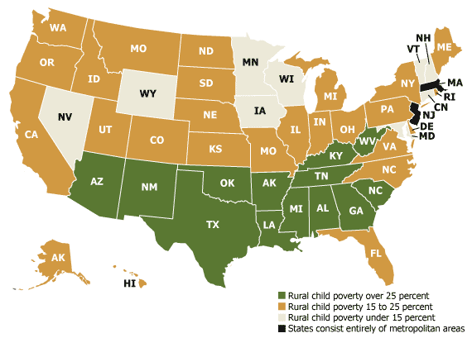
Where are our children in poverty?
http://www.prb.org/Publications/Articles/2009/ruralchildpoverty.aspx

Slide 5
What does research say about poverty?
Overall, 15% of Americans are currently living in poverty. This is the first time the poverty rate has remained at or above 15% three years running since 1965.
For children under the age of 18, the poverty rate was 21.9% in 2011.
In 2011 it was 13.75% for ages 18-64 and 8.7% for 65 and older.
Current poverty rate = $23,492 a year for a family of four, or $11,720 for an individual.
Census first began tracking poverty rates in 1959, the rate in 59 was 22.4%.
Household median income was $51,017 in 2012.
Poverty and unemployment lead to property-related crimes (burglary, larceny, theft, motor vehicle theft, arson, shoplifting, and vandalism).
Crime creates “a vicious cycle of unemployment, economic downturns, and instability”.
Where there is poverty, there is crime.

Slide 6
Why childhood poverty is on the rise
Household median income was $51,017 in 2012.
By race: Asians, 68,600. Whites, 57,000. Hispanics, 39,000. Blacks, 33,300.
Poverty rates do not include government benefits and “the effects of medical and work expenses on the cost of living. It is also not adjusted for regional differences in housing costs.”
Dropout rates are 7-times higher among low income homes than their higher income peers (Dosomething.org).
The lowest-performing high schools produce 58% of all African-American dropouts and 50% of all Hispanic dropouts, compared to 22% of all white dropouts (Dosomething.org).

Slide 7
Impact of poverty on children
Research indicates that poverty does have an impact on child development and academic achievement (Brooks-Gunn & Duncan, 1997; McLoyd, 1998; Bradley & Corwyn, 2002; Sirin, 2005; Yoshikawa, Aber, & Beardslee, 2012).
Effects of poverty on children development can be categorized under three main headings:
  Physical Development
  Cognitive and Academic Development
  Emotional/ Behavioral Development

Slide 8
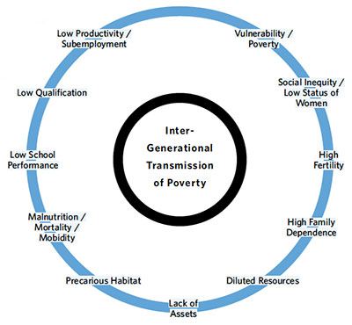
http://unfpa.org/psa/second-part-1-4-1/

Slide 9
Physical Development
Relation begins before birth:
  Premature birth, low birth weight, birth defects, asphyxia, and higher rates of health complications (Hawley & Disney, 1992; US Department Health & Human Services, 2000b, Vrijheid et al. 2000).
  Poverty is associated with conditions such as
  Inadequate nutrition, asthma, limited access to health care, and exposure to tobacco smoke (Bornstein, 1995;US Department Health & Human Services, 2000b).
  Environmental Factors:
  Lead paint, toxic waste dumps, and pollution (US Department Health & Human Services, 2000b).
  Adolescents:
  Depression, obesity, and systolic blood pressure (US Department Health & Human Services, 2000a,b).

Slide 10
  Cognitive and Academic Development
“For over 70 years findings on the relationship between SES and intellectual/academic competence has accumulated”
(Bradley& Corwyn, 2002, p. 375)
Cognitive and academic development of a child can be impacted by many different factors:
The mother’s IQ, education, and prenatal care (e.g. drug use)
Stress
Limited exposure to stimulating and educational activities
Limited access to quality schooling and academic failure (Hawley & Disney, 1992; Korenman et al., 1995)
Poverty can cause;
Low academic achievement test scores, low graduation rates, and low levels of high school completion.
High rates of grade retention, drop outs, and special education placement (Haveman & Wolfe, 1995; Conger, Conger, & Elder, 1997).

Slide 11
  Emotional/ Behavioral Development
  Transitive poverty vs. persistent poverty
“Persistent poverty is a significant predictor of some behavioral problems”(Brooks-Gunn & Duncan, 1997, p.63).
Internalizing and externalizing symptoms (Brooks- Gunn & Duncan, 1997).
Limited interaction with the child (Yoshikawa, 1994).
Children in a low SES settings are a higher risk of developing psychological disturbances, depression, and maladaptive social functioning (Brooks- Gunn & Duncan, 1997; McLoyd, 1997).

Slide 12
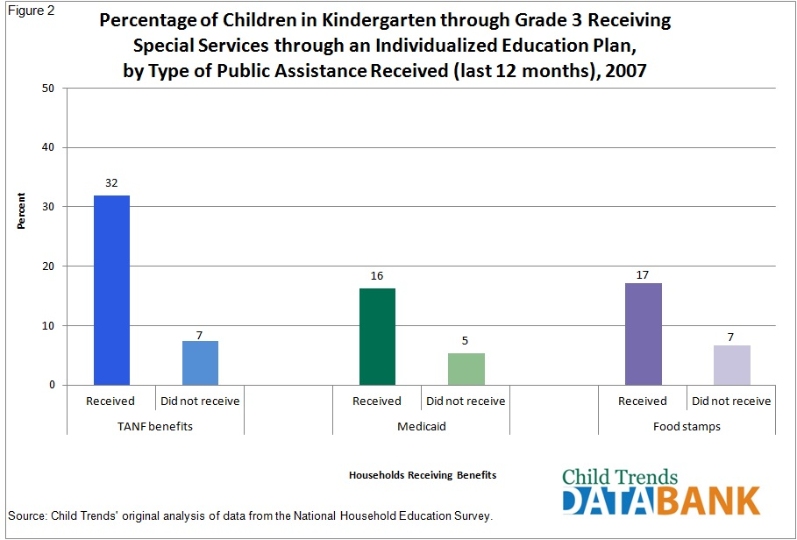

Slide 13

What are schools doing about poverty?
Head Start programs
Title 1 Reading programs
After school programs
Free and reduced lunch
Policy reform to increase
  test scores: NCLB, AYP
Retention policies to improve
reading ability and scores
Programs to retain teachers in high-poverty schools

Slide 14
What schools are not doing about poverty?
Closing the gaps; opportunities, outcomes
Fully-financing programs.
Proven that testing will increase outcomes for children in poverty.
Retaining high quality teachers in urban schools.
Providing additional funding for students with disabilities in poverty.

Slide 15
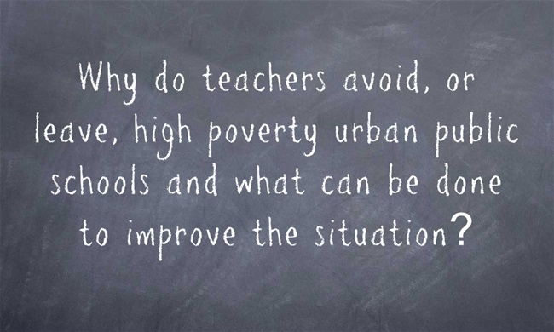

Slide 16
What can be done for students with disabilities who are also living in poverty?
Understand that stressors are an aspect of poverty
  Familial focus back on student and education
Agencies may need to interact at a higher rate and an earlier age
  Head Start, Pediatric Programs, Community Agencies
  Educate parents who may lack the knowledge of resources

Slide 17

Teachers need to be proactive
  Advisement on early intervention services
  Advocate for testing
    “They will come around,” no longer works
  Be cognizant of bias
Increase quality community programs
  Affordable childcare
  Access to educational settings not affiliated with school (libraries, museums, etc.)
  With high levels of poverty, there needs to be a supportive interaction between the schools, families, and community entities.
  Teachers need to be educated based on the needs of the community they serve
  Families need to be educated on the types of services and supports that exist for those with disabilities
  Communities need to provide training and free/discounted services to supplement and support the schools and families

Slide 18
Poverty Studies
“NYC’s special education reorganization had two major goals: to get special ed teachers back in classrooms and to thoroughly train them in research based interventions” (Sausner, 2004, p. 58).
“ For although income and skin pigment don’t directly cause low achievement, the characteristics that in general define social-class differences inevitably influence learning” (Rothstein, 2004, p. 40).
“In sum, the relationships among race or ethnicity, poverty, and the disproportionate placement of minority students in special education are highly complex, and their directionality often defies expectation” (Skiba et al., 2005, p.139).
What is the context of income?
Areas for future study…

Slide 19
Resources
Almy, S., & Theokas, C. (2010). Not Prepared for Class: High-Poverty Schools Continue to Have Fewer In-Field Teachers. Education Trust.
Bornstein, M. H. (1995). Parenting infants. Handbook of parenting, 1, 3-43.
Bradley, R. H., & Corwyn, R. F. (2002). Socioeconomic status and child development. Annual review of psychology, 53(1), 371-399.
Brooks-Gunn, J., & Duncan, G. J. (1997). The effects of poverty on children. The future of children, 55-71.
Child Trends. (2014). http://www.childtrends.org/databank/
Children’s Defense Fund. (2000). Retrieved from http://www.childrensdefense.org
Conger, R. D., Conger, K. J., & Elder, G. H. (1997). Family economic hardship and adolescent adjustment: Mediating and moderating processes. Consequences of growing up poor, 34.
Dosomehting. (2014). https://www.dosomething.org
Freeman, R. B. (2010). It's financialization!. International Labour Review, 149(2), 163-183.
Haveman, R., & Wolfe, B. (1995). A Review of Methods and Findings. Journal of economic literature, 33(4), 1829-1878.
Hawley, T. L., & Disney, E. R. (1992). Crack's children: The consequences of maternal cocaine abuse. Society for Research in Child Development.
Korenman, S., Miller, J. E., & Sjaastad, J. E. (1995). Long-term poverty and child development in the United States: Results from the NLSY. Children and Youth Services Review, 17(1), 127-155.
McLoyd VC. 1997. The impact of poverty and low socioeconomic status on the socioemotional functioning of African-American children and adolescents: mediating effects. In Social and Emotional Adjustment and Family Relations in Ethnic Minority Families, ed. RD Taylor, M Wang, pp. 7–34. Mahwah, NJ: Erlbaum. 239 pp.
McLoyd, V. C. (1998). Socioeconomic disadvantage and child development. American psychologist, 53(2), 185.
Rothstein, R. (2004). Class and schools: Using social, economic, and educational reform to close the achievement gap. Washington, DC: Economic Policy Institute.
Rothstein, R. (2004). The achievement gap: Closing the achievement gap requires more than just improving schools. Educational Leadership, November, 40-43.
Sausner, R. ( 2004). Children first. District Administration, December 2004, 54-58.
Sherman, J. (2006). Coping with rural poverty: Economic survival and moral capital in rural America. Social Forces, 85(2), 891-913.
Sirin, S. R. (2005). Socioeconomic status and academic achievement: A meta-analytic review of research. Review of educational research, 75(3), 417-453.
Skiba, R. J., Poloni-Staudinger, L., Simmons, A. B., Feggins-Azziz, L. R., & Chung, C. G. (2005). Unproven Links Can Poverty Explain Ethnic Disproportionality in Special Education?. The Journal of Special Education, 39(3), 130-144.
Taylor, P., Lopez, M. H., Passel, J. S., & Motel, S. (2011). Unauthorized immigrants: Length of residency, patterns of parenthood. Pew Hispanic Center.
U.S. Census Bureau. (2011). Income, poverty, and health insur­ance coverage in the United States: 2010. Washington, DC: Author. Retrieved from http://www.census.gov/prod/2011pubs/p60-239.pdf
US Dep. Health Hum. Serv. 2000a. Child Health USA 2000. Washington, DC: US GPO
US Dep. Health Hum. Serv. 2000b. Healthy People 2010. Washington, DC: US GPO
Vrijheid, M., Dolk, H., Stone, D., Abramsky, L., Alberman, E., & Scott, J. E. S. (2000). Socioeconomic inequalities in risk of congenital anomaly. Archives of Disease in Childhood, 82(5), 349-352.
Yoshikawa, H. (1994). Prevention as cumulative protection: effects of early family support and education on chronic delinquency and its risks. Psychological bulletin, 115(1), 28.
Yoshikawa, H., Aber, J. L., & Beardslee, W. R. (2012). The effects of poverty on the mental, emotional, and behavioral health of children and youth: Implications for prevention. American Psychologist, 67(4), 272.

