Slide 1
Staying Safe in Your Relationships
For PACC
Amanda Ringold, BSN, RN, CEN, SANE-A

Slide 2

Safe People
Nurses
Doctors
Teachers
Support staff/hab aids
Family

Slide 3
What if you feel uncomfortable?
Say NO!
Be assertive!

Slide 4
Times when being uncomfortable is okay
At the Doctor’s Office
Sometimes doctors or nurses need to touch and look at your private parts and it makes us feel uncomfortable, but its really important for this to happen to keep us healthy.
Its okay to have someone you trust in the room with you.

Slide 5
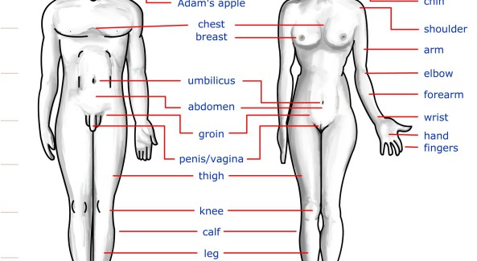
Anatomy

Slide 6
Private Parts
PRIVATE
Ok to touch or show these parts when:
  You’re alone
  In the bathroom
  At the doctor’s office

Slide 7
Sex
Sex or sexual acts are when two people who both say its okay, or consent, touch the other person’s private parts.
Okay to do with your girlfriend, boyfriend, husband, or wife and only if you trust that person and have been with that person for a long time.

Slide 8
Sex
Its ALWAYS okay to say NO.
Just because you have a girlfriend, boyfriend, or spouse does not mean you have to do sexual acts.

Slide 9
Safe Sex
Always use condoms
EVERY SINGLE TIME
To avoid Sexually Transmitted Diseases
To avoid Pregnancy

Slide 10
Sex Laws
Illegal to have sex with anyone under 18 years old
Illegal for an adult to talk about and show pictures of sex to a child
Illegal to pay someone for having sex
Illegal to take money or gifts for having sex

Slide 11
Who to talk about sex with
Outside of class, only talk about sex with ADULTS that you trust.
NEVER talk about sex at school or work
  Sexual harassment

Slide 12
Sexual Predators
A person who finds a vulnerable person to take advantage of
They lie to you!
They try to get you to trust them

Slide 13
Who is a predator?
Very hard to tell
Can be young or old, man or woman.
Some predators are rapists- they force people to do sexual acts when the person does not want to.

Slide 14
Red Flags
May say they want a “secret friendship” and not to tell anyone that you spend time together.
May give gifts
May have pets
May send you inappropriate things on the internet or pretend to be someone they’re not online

Slide 15
Be cautious when approached by someone who makes you feel uncomfortable
Always tell someone you trust

Slide 16
Sexual Assault
Never okay!
NEVER:
  Touch someone if they don’t want to be touched.
  Make someone drink too much.
  Talk to people walking alone at night

Slide 17
Sexual Assault: Ways to Stay Safe
Buddy system
Always tell someone you trust where you’re going when you go out
If someone makes you feel uncomfortable, get away any way that you can.
Say NO!
Never go into a stranger’s home or car
Never leave your drink unattended at a bar

Slide 18
Phone Apps
http://www.protection1.com/campus-safety/student-safety-apps/#.VE5qZ-dsjgU
Use these when out alone

Slide 19
What to do
If you do find yourself in a situation where someone is making you do sexual things that you don’t want to:
  Get away!
  Call 911
  Call your parents or someone you trust
  Do not shower, change your clothes, eat/drink, go to the bathroom
  Go to the Emergency Room and tell the doctors and nurses what happened

Slide 20
Questions?
Write down your questions!
hendersonar@upmc.edu

